Slide 1
Private School Earthquake Safety Working Group Activities
I will tell you about:
Working Group process and participants
Working Group investigations and findings

Slide 2
Working Group process and participants
Official meetings began in December of 2012
All meetings were open to the public and publicly noticed
Multiple efforts were made to invite all private schools to participate
Report completed at end of 2103
Working group attendees:
Parents, trustees, earthquake specialists, schools, concerned members of public

Slide 3
Working Group investigated these issues:
What is risk of SF private school buildings in earthquakes?
How does that risk compare to risk of public school buildings?
How does that risk compare to what the public thinks the risk is?
What do we recommend the City of SF do to address the risk?

Slide 4
1) What is risk of SF private school buildings in earthquakes?
Vulnerability of San Francisco Private School Buildings
Buildings whose characteristics indicate they might perform poorly in future earthquakes
Buildings whose characteristics indicate they are likely to perform well in future earthquakes
Buildings for which there is not enough information to determine likely seismic performance

Slide 5
2) How does that risk compare to risk of public school buildings?
Public Schools Private Schools
Buildings whose characteristics indicate they might perform poorly in future earthquakes
Buildings whose characteristics indicate they are likely to perform well in future earthquakes
Buildings for which there is not enough information to determine likely seismic performance

Slide 6
Why is the risk different?
The 1933 Long Beach, CA earthquake:
70 Public schools destroyed
120 Public schools had major damage
Jefferson Junior High, Long Beach

Slide 7
3) How does the risk compare to what the public thinks?
51% of parents think public, private and charter schools held to same structural standards (27% don’t know)
59% of parents think all SF schools are “very safe” or “safe enough” (18% don’t know)
60% of parents said seismic risk not considered in school decision

Slide 8
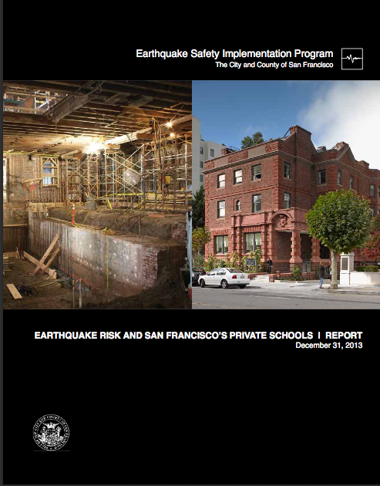
4) What do we recommend the City of SF do to address the risk?
All private schools must evaluate the earthquake risk of their buildings within three years of passage of ordinance.
The results are public information.

